Slide 1
Caffeine Exposure in Shore Crabs
By: Ash Hopkins, Aubrey Henwood, Sophia Eckhart and Marco Martinez

Slide 2
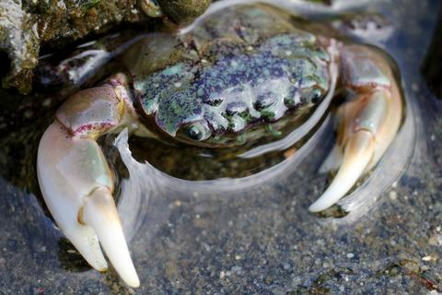
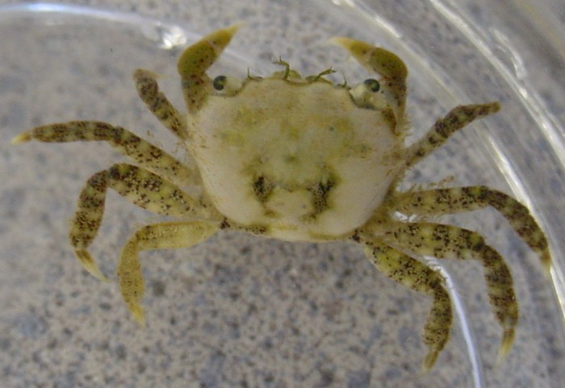
Model Organism
Hemigrapsus oregonensis = Hairy Shore Crab
Range: Resurrection bay, Alaska to Baja California, Mexico
Intertidal Species (Often estuarine)
Appear in many colors and often misidentified (Caldwell, 2022)
Effective osmoregulators (Cowles, 2005)
Notes:
Marco: Beginning with the crabs that are the main focus of our experiment, we have the Hemigrapsus oregonensis commonly known as the hairy shore crab, mudflat crab, Oregon shore crab, etc. These are native crabs of the Pacific Northwest, ranging from Resurrection Bay, Alaska down to Baja California, Mexico that live in the intertidal zone, often around estuaries. These crabs are fairly small, only around 5 cm wide and can range in a wide variety of colors, often yellow, green, purple, white, red, etc. which often lead to them being misidentified for other crab species such as the purple shore crab and Eurasian green crab. Since these crabs inhabit the intertidal region, they are effective osmoregulators and can live in more hypo/hypersaline environments compared to other shore crabs. As will be seen soon, these crab’s close approximation to the shore exposes them more significantly to introduced caffeine.

Slide 3
Caffeine in the Environment
Representative pharmaceutically active compound pollutant (Li et al., 2020)
Used as marker of anthropogenic activities (Hillebrand et al., 2012)
Caffeine concentrations found in marine organism tissues after long-term exposure (Vieira et al., 2022)
Negatively influences marine species’ abundance, biomass, and fitness (Vieira et al., 2022)
Delayed hatch time and embryo development (Garcia et al., 2014)
Notes:
Marco: Now we get to the compound that our group wanted to focus on, caffeine. Caffeine is a common compound pollutant widely consumed by us and hence is a marker of anthropogenic activities. As a result, caffeine tends to enter our waterways and bypasses most filtration systems, reaching bodies of water in fairly small concentrations. Despite this, caffeine has proven itself to be detrimental to many organisms and generally affects their populations as caffeine is known to delay hatch time and embryo development.

Slide 4
Caffeine Effects on Crabs
Decreases in the lysosomal membrane stability and depolarizes the membrane (Aguirre-Martínez et al., 2012; Hermann, 1981)
Disrupts enzyme and nerve activity in the digestive tract (Baracchini et al., 2024)
Induces tension in muscle cells by lowering threshold (Huddart, 1969)
Effects on the Na+/K+-ATPAse transporter (Ortega et al., 2014; Sá & Zanotto, 2013)
Increased flux of intracellular Cd and Cu in gill cells (Ortega et al., 2014; Sá & Zanotto, 2013)
Notes:
Marco: On crabs specifically, caffeine has been found to reduce the stability and depolarize the lysosomal membrane, disrupts enzyme and nerve function in the digestive tract, induce tension in muscle cells, and affects the sodium pump. This all results in lethargic behavior, trouble moving limbs, and causes the crabs to become exhausted.

Slide 5
Question and Hypotheses
Q: How do different environmental concentrations of caffeine facilitate physiological stress responses in Hemigrapsus oregonensis?
Null: Different environmental concentrations of caffeine will have no effect on the physiological stress response in Hemigrapsus oregonensis.
Alt: Higher environmental concentrations of caffeine will have an increased effect on the physiological stress response in Hemigrapsus oregonensis
Increased lactate, oxygen consumption and righting times
Notes:
Ash

Slide 6
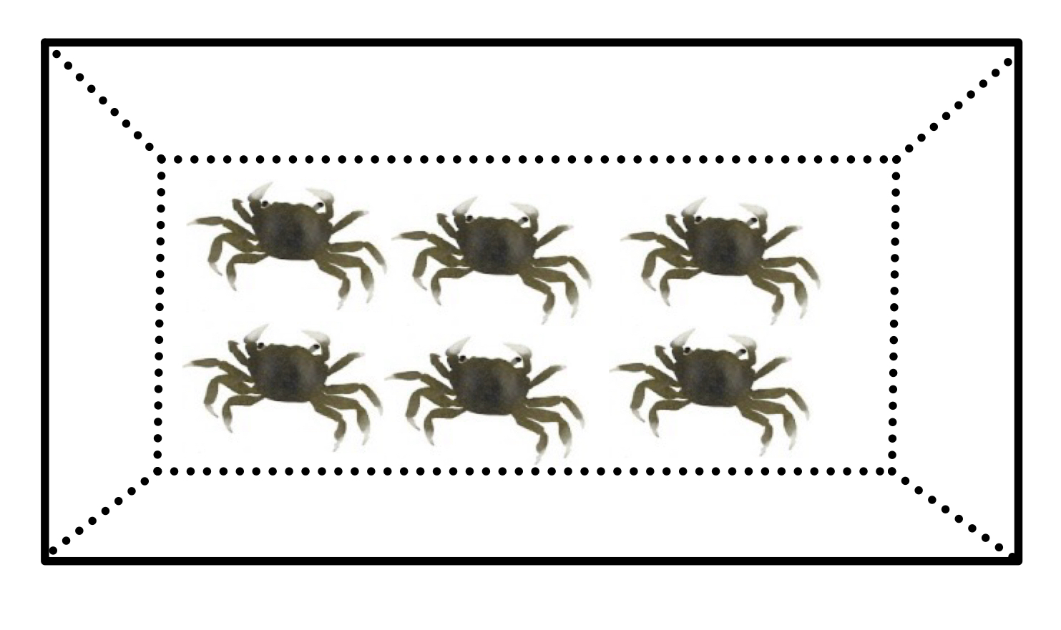
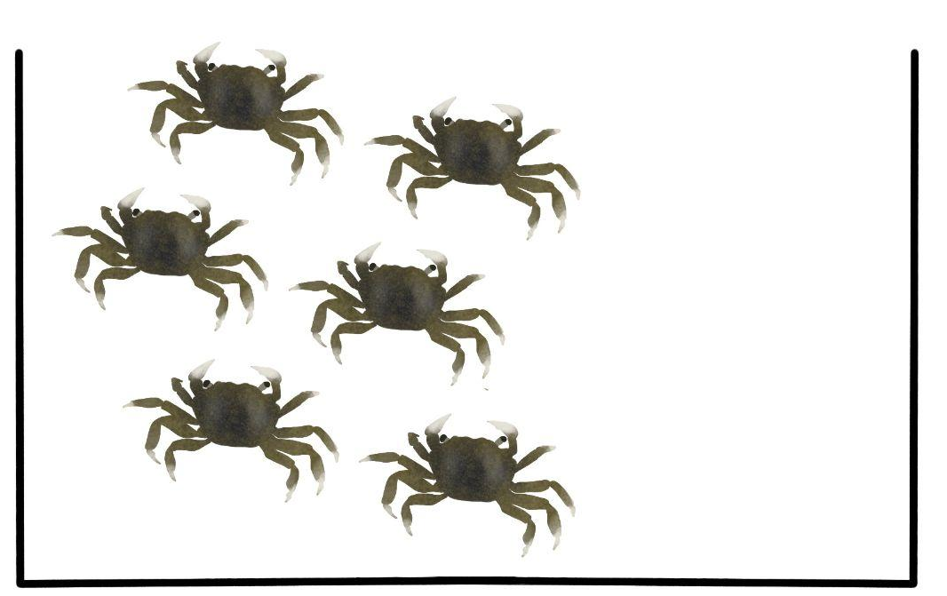
Experimental Design
Control
3L tanks, filled with 2.5 L of water
Dosed with powdered capsules of caffeine
Control
Low Dose
Medium Dose
High Dose
5 μg/L
15 μg/L
20 μg/L
5 μg/L of caffeine
15 μg/L of caffeine
20 μg/L of caffeine
Notes:
Ash
To conduct this experiment, we set up three 3L tanks with 2.5 L of water and six crabs per tank. To add caffeine to the water, we used powdered capsules of caffeine and dissolved the powder into a beaker before adding doses to each tank. The first tank had our low dose of caffeine, 5 ug/L of caffeine. The second tank had 15 ug/L of caffeine, being our medium dose treatment. Finally, our high dose tank had 20 ug/L of caffeine. We used this course’s communal control group as our control for this experiment. Controlled variables across all four tanks include: temperature, salinity, and no addition of food (crabs were starved for the duration of testing).

Slide 7
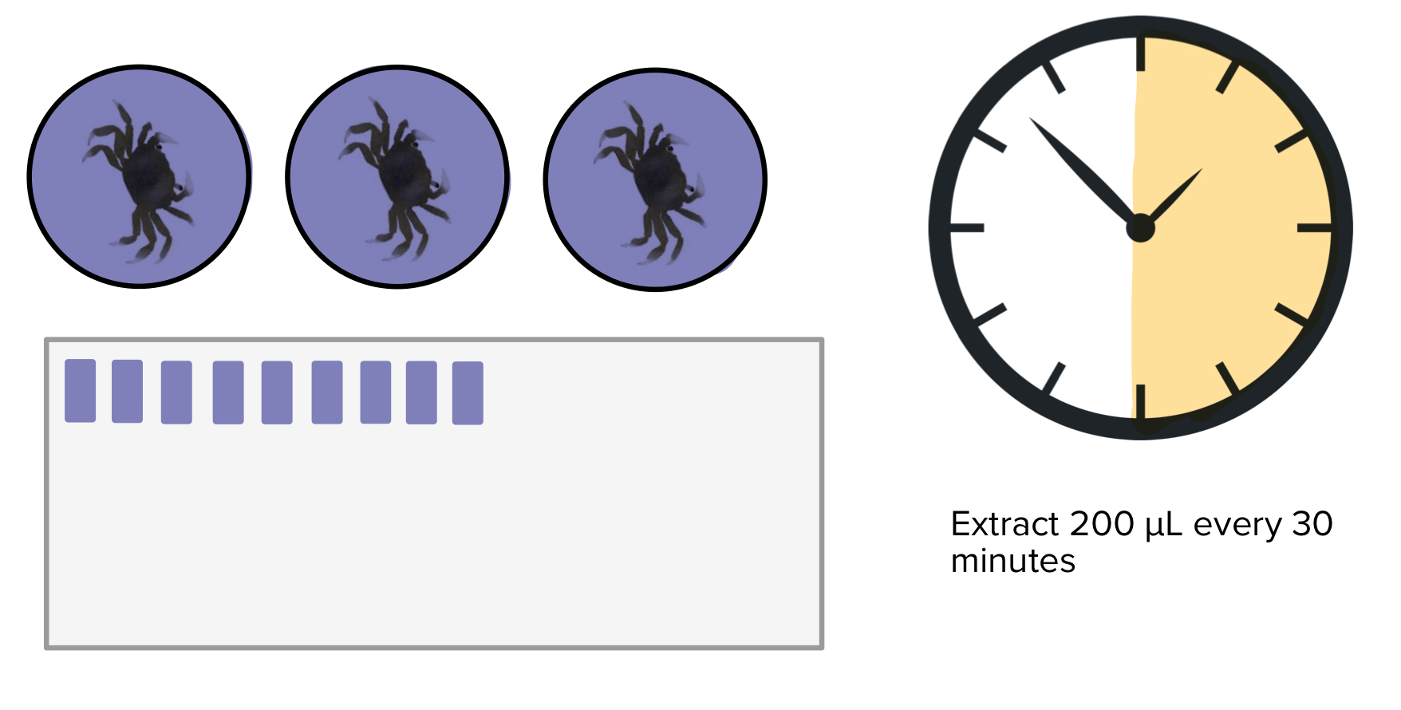
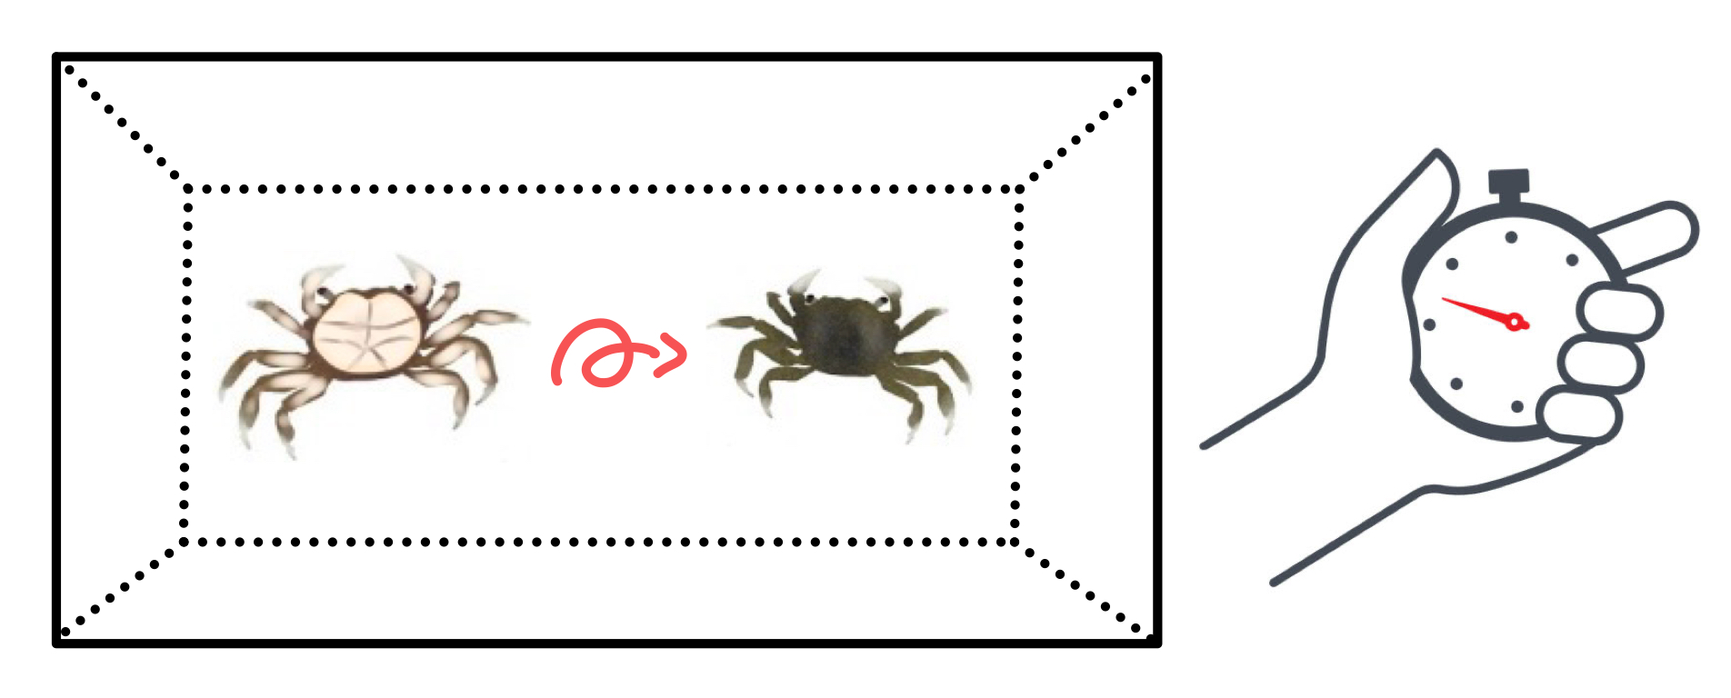
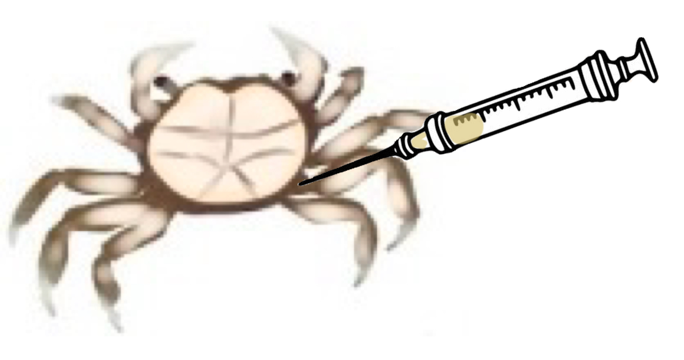
Data Collection
Week 0:
Establish caffeine concentrations
Week 1:
Re-dose tanks with caffeine
Respiratory and righting time
Week 2:
Record hemolymph, respiratory and righting time
Hemolymph Assay:
Lactate
Notes:
Ash
During the first week testing commenced, we established caffeine concentrations within our tanks. Problems arose with the method of caffeine we had initially sought out to use, meaning that week 0 was actually just the week in which we dosed all of the tanks with their treatments of caffeine. All testing was delayed until week 1, meaning that all tests taken were after a week of exposure to caffeine. At the very start of week 1, we re-dosed tanks with caffeine. We then performed righting time tests. Every living individual was measured from each tank. We began by flipping crabs onto their backs, against the bottom of their tank. The second we let go of the crab, a stopwatch began. After righting times were taken, we conducted resazurin tests to determine the oxygen consumption and metabolic rate of the crabs.

Slide 8
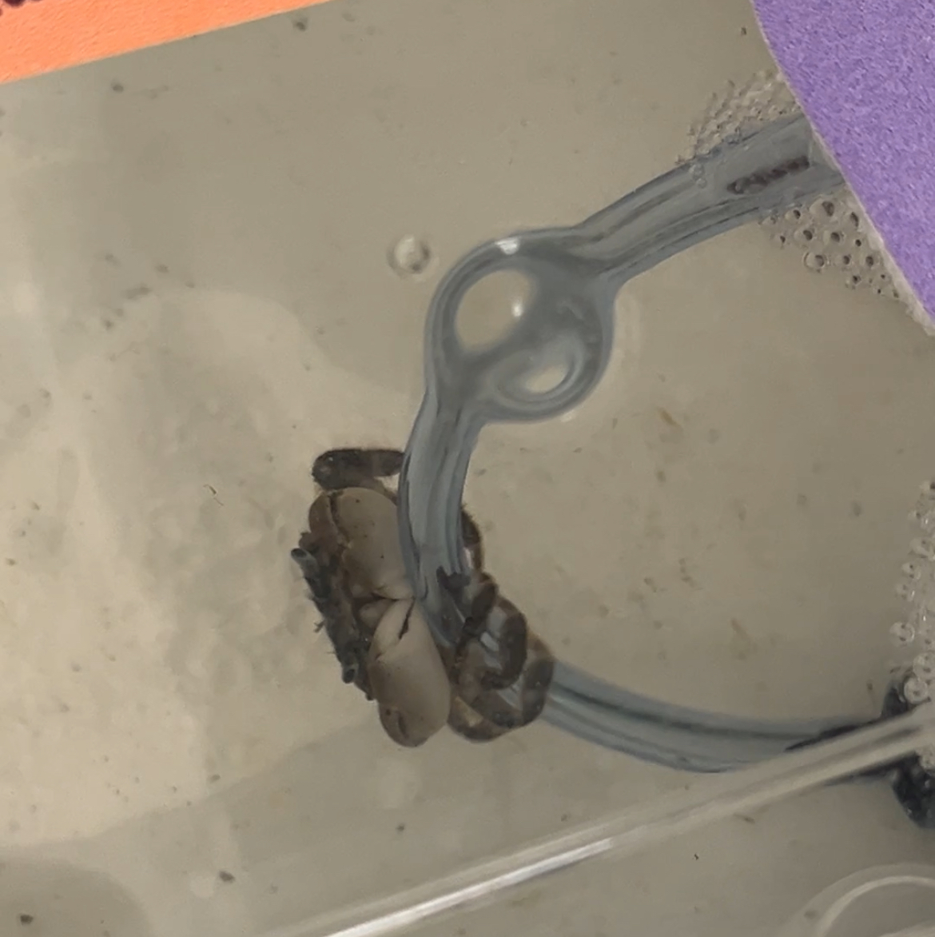
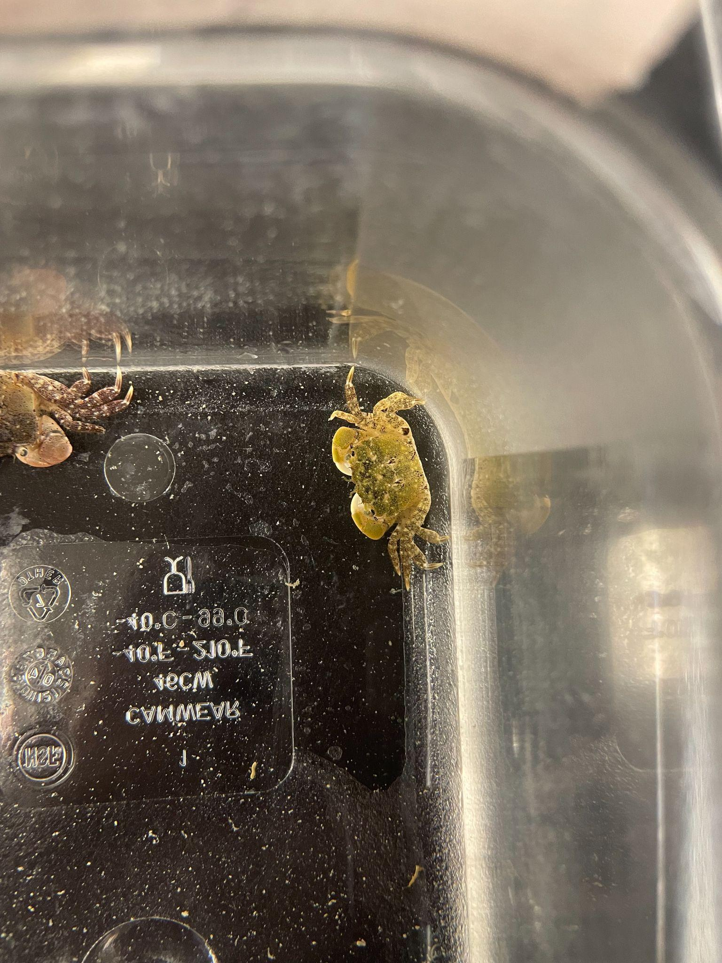
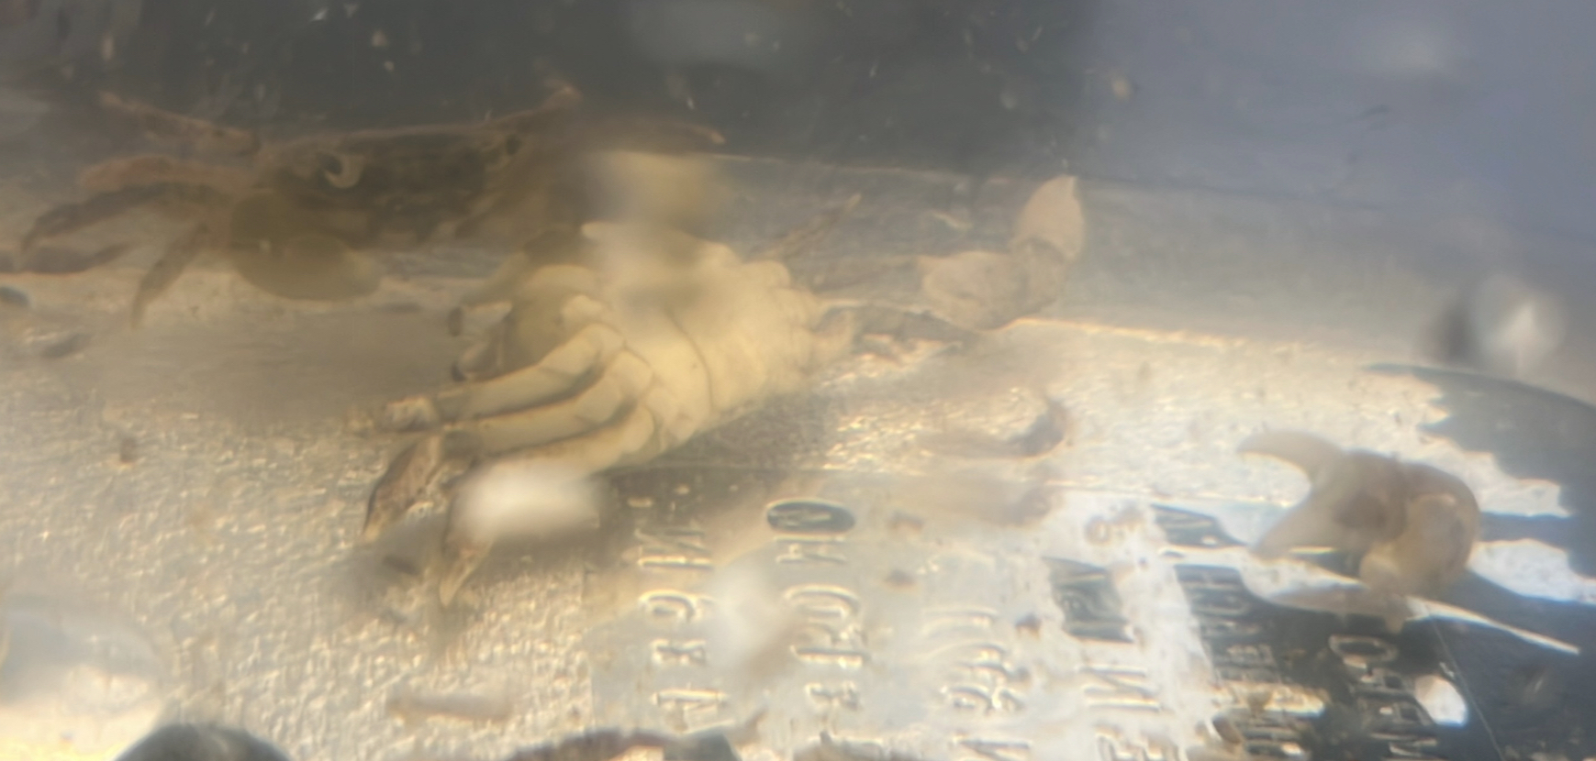
Behavioral Observations
Leg contractures (20 μg/L)
Death and possible cannibalization(20μg/L)
Crab climbing aeration tubing
(15 μg/L)
A low-dose and a high-dose crab escaped
Notes:
Sophia

Slide 9
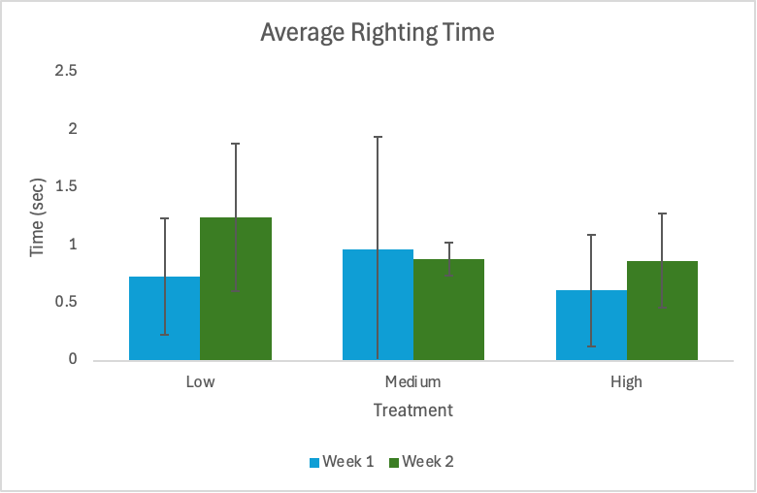
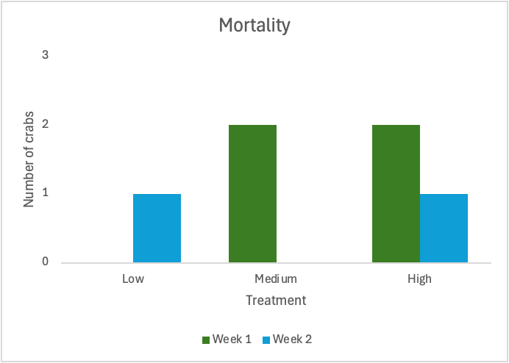
Results: Righting Time and Mortality
Notes:
Sophia

Slide 10
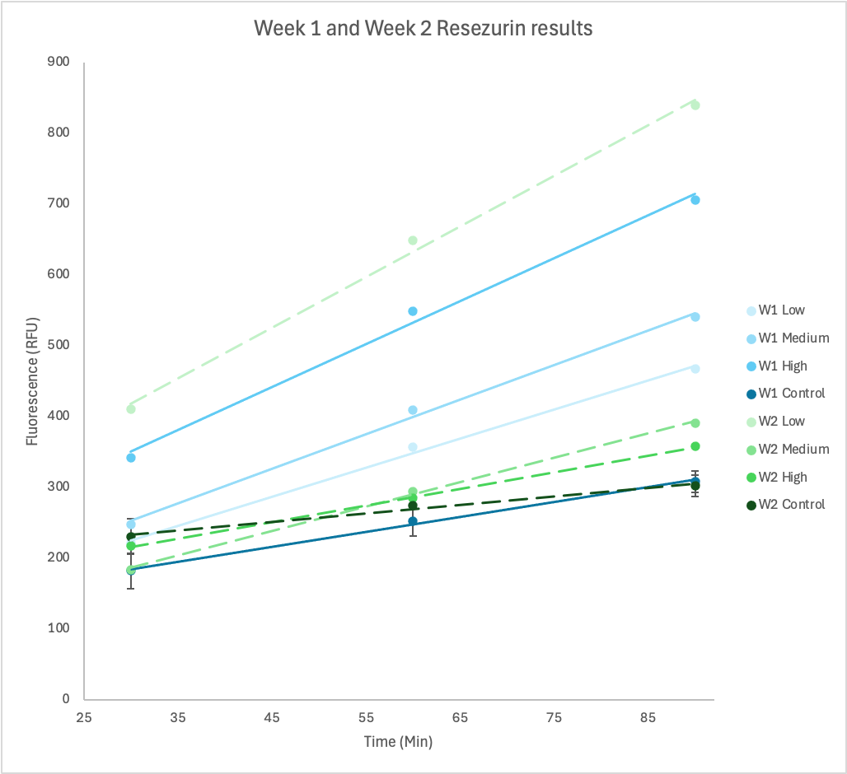
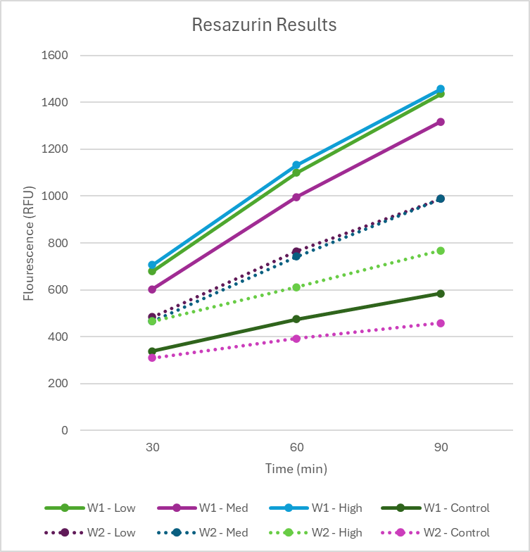
Results: Resazurin
Rate of O2 consumption as a proxy for cellular respiration
W1: Highest rate from High Dose
Reverse trend seen in Week 2
W2: Highest rate from Low Dose
Notes:
Sophia

Slide 11
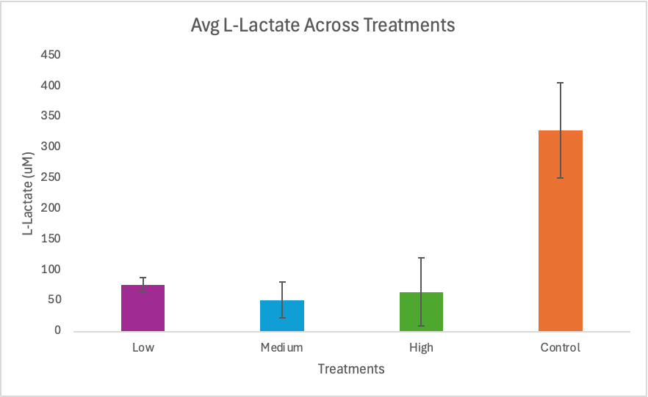
Results: Hemolymph
Statistically significant differences between treatments
Higher rates of fermentation in control group
Notes:
Aubrey
On the biochemical side, lactate concentrations provided confirmation of the stress response. The control group had the highest lactate levels; however they were continuously exposed to stressors (hands reaching in tank, crabs being pulled, etc.) which most likely contributed to the high levels. The high dose tank showed elevated levels compared to medium and low dose tanks, which is consistent with a strong metabolic stress response to caffeine.

Slide 12
Conclusion/Interpretation
The results state that caffeine can induce behavioral, metabolic and physiological stress effects in H. oregonensis over varied concentrations.
Notes:
Aubrey
Combined, these results stipulate that caffeine can induce behavior, metabolic and physiological stress in H. oregonensis over varied concentrations.
This suggests a decline in physical response likely due to cumulative caffeine exposure. With mortality throughout all treatment levels, this suggests that even small concentrations of caffeine can compromise crab health over time.

Slide 13
Future questions
How will more closer concentrations of caffeine (5 μg/L, 7μg/L, 9μg/L) affect crab physiology and behavior?
Critical tissue level threshold
How much did other environmental stressors affect the results collected?
How would long term exposure (30+days) affect crab physiology and stress response?
Notes:
Aubrey
Our study left us with a few questions and some ideas of what to do in moving forward with experiments in this topic. The first question is what would closer concentrations of caffeine do to our results? We picked three values, that were quite separate (by 5u/l) rather than like 2 u/l. A limitation of this experiment was the environmental stressors of being moved around, other people reaching into tanks, etc. It’d be interesting to see if the stress results changed due to a calmer environment that was more controlled. Another curious point was how would long term exposure effect the crabs? We were able to do this experiment for two weeks, but often exposure could last longer than that. Especially if whatever is causing the exposure is leaking slowly.
These are all future experiment parameters that we would consider in moving forward.

Slide 14
Bibliography
Aguirre-Martínez, G. V., Buratti, S., Fabbri, E., Valls, D., & Martín-Díaz, M. L. (2012). Stability of lysosomal membrane in Carcinus maenas acts as a biomarker of exposure to pharmaceuticals. Environmental Monitoring and Assessment, 185(5), 3783–3793. https://doi.org/10.1007/s10661-012-2827-2
Aguirre-Martínez, G. V., Del Valls, T. A., & Martín-Díaz, M. L. (2013). Identification of biomarkers responsive to chronic exposure to pharmaceuticals in target tissues of Carcinus maenas. Marine Environmental Research, 87-88, 1–11. https://doi.org/10.1016/j.marenvres.2013.02.011
Baracchini, C., Messager, L., Stocker, P., & Leignel, V. (2024). The Impacts of the Multispecies Approach to Caffeine on Marine Invertebrates. Toxics, 12(1), 29. https://doi.org/10.3390/toxics12010029
Caldwell, L. (2022, October 3). Hairy shore crab. Coastal Interpretive Center. https://interpretivecenter.org/hairy-shore-crab/
Cowles, D. (2005). Hemigrapsus oregonensis. Inverts.wallawalla.edu. https://inverts.wallawalla.edu/Arthropoda/Crustacea/Malacostraca/Eumalacostraca/Eucarida/Decopade/Brachyura/Family_Grapsidae/Hemigrapsus_oregonensis
Cruz, D., Almeida, Â., Calisto, V., Esteves, V. I., Schneider, R. J., Wrona, F. J., Soares, A. M. V. M., Figueira, E., & Freitas, R. (2016). Caffeine impacts in the clam Ruditapes philippinarum: Alterations on energy reserves, metabolic activity and oxidative stress biomarkers. Chemosphere, 160, 95–103. https://doi.org/10.1016/j.chemosphere.2016.06.068
FD. (2017, December 9). English: Caffeine molecular structure (ACS style). Wikimedia Commons. https://commons.wikimedia.org/wiki/File:Caffeine_structure.png
Garcia, R. N., Chung, K. W., DeLorenzo, M. E., & Curran, M. C. (2014). Individual and mixture effects of caffeine and sulfamethoxazole on the daggerblade grass shrimpPalaemonetes pugiofollowing maternal exposure. Environmental Toxicology and Chemistry, 33(9), 2120–2125. https://doi.org/10.1002/etc.2669
Hermann, A. (1981). Action of caffeine on pyloric motorneurons in the crustacean stomatogastric ganglion. Comparative Biochemistry and Physiology Part C: Comparative Pharmacology, 69(2), 191–197. https://doi.org/10.1016/0306-4492(81)90128-3
Hillebrand, O., Nödler, K., Licha, T., Sauter, M., & Geyer, T. (2012). Caffeine as an indicator for the quantification of untreated wastewater in karst systems. Water Research, 46(2), 395–402. https://doi.org/10.1016/j.watres.2011.11.003
Huddart, H. (1969). Caffeine activation of crab skeletal muscle. Comparative Biochemistry and Physiology, 29(3), 1031–1038. https://doi.org/10.1016/0010-406x(69)91005-6
Li, S., Wen, J., He, B., Wang, J., Hu, X., & Liu, J. (2020). Occurrence of caffeine in the freshwater environment: Implications for ecopharmacovigilance. Environmental Pollution, 263, 114371. https://doi.org/10.1016/j.envpol.2020.114371
Ortega, P., Custódio, M. R., & Zanotto, F. P. (2014). Characterization of cadmium plasma membrane transport in gills of a mangrove crab Ucides cordatus. Aquatic Toxicology, 157, 21–29. https://doi.org/10.1016/j.aquatox.2014.09.006
Sá, M. G., & Zanotto, F. P. (2013). Characterization of copper transport in gill cells of a mangrove crab Ucides cordatus. Aquatic Toxicology, 144-145, 275–283. https://doi.org/10.1016/j.aquatox.2013.10.018
Vieira, L. R., Soares, A. M. V. M., & Freitas, R. (2022). Caffeine as a contaminant of concern: A review on concentrations and impacts in marine coastal systems. Chemosphere, 286(2), 131675. https://doi.org/10.1016/j.chemosphere.2021.131675
Notes:
https://inverts.wallawalla.edu/Arthropoda/Crustacea/Malacostraca/Eumalacostraca/Eucarida/Decapoda/Brachyura/Family_Grapsidae/Hemigrapsus_oregonensisWhiteDLC2005e.jpg

